Slide 1
SEMINAR ARTERIAL PULSE CHAIR PERSON DR SAJEER K T ASSISTANT PROFESSOR DEPT OF CARDIOLOGY GMCH CALICUT PRESENTER DR FARHAN P K CARDIOLOGY RESIDENT GMCH CALICUT
Date : 07/03/2023

Slide 2
REFERENCES
Braunwalds text book of cardiology :12th edition
FUSTER & HURSTS : The heart
Essentials of bedside cardiology by JULES CONSTANT
Textbook of medical physiology by GUYTON and HALL 12th edition
Synopsis of cardiac physical diagnosis by JONATHAN ABRAMS
JACC : normal vascular aging: differential effects on wave reflection and aortic pulse wave velocity: the anglo-cardiff collaborative trial (acct)
Frontiers in cardiovascular medicine : arterial stiffness and hypertension in the elderly stephane laurent and pierre boutouyrie
The british medical journal vol. 1. No.1629, march 19, 1892
Clinical methods in cardiology B Somaraju

Slide 3
Topics included…..
Pulse – definition, history
Pulse wave form & physiologycal properties
Methods of examination
Types of pulse
Abnormal conditions, clinical importance

Slide 4
DEFINITION
MIRROR OF HEART
Palpable waveform propagating through the vessel wall - forward & laterally @ faster than blood column

Slide 5
TRANSMISSION OF PRESSURE PULSE

Slide 6
VELOCITY OF PRESSURE PULSE TRANSMISSION :
AORTA : 3 - 5 M/SEC
LARGE ARTERIAL BRANCHES : 7 - 10 M/SEC
SMALL ARTERIES : 15 - 35 M/SEC
GREATER THE COMPLIANCE OF EACH VASCULAR SEGMENT, SLOWER THE VELOCITY
Notes:
Ao 1 m/sec
Smaller arteries .5 to 2 m/sec

Slide 7
DETERMINANTS OF ARTERIAL PULSE
LV
AV
ARTERY
STROKE VOLUME
CONTRACTILITY
EJECTION VELOCITY
NORMAL
STENOTIC
REGURGITANT
COMPLIANCE
PVR
RUN-OFF
Notes:
Greater the SV, greater the amount of blood that is accommodated in the arterial tree with each systoli greater the pressure rise and fall during systole and diastole, causing a greater pulse pressure
Conversely, less the compliance of the arterial system, the greater the rise in pressure for a given stroke volume.

Slide 8
HISTORICAL MILESTONES
HIPPOCRATES --- ARTERIES ARE AIR DUCTS
GALEN ---
Arteries contain blood , not air
HEROPHILUS --- Arterial & cardiac pulse were synchronous
HALES, FRANK --- WINDKESSEL MODEL

Slide 9
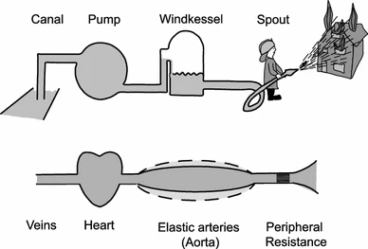
WINDKESSEL MODEL
Notes:
Windkessel is a tank (capacitance reservoir) pressurized with a pump and connected to a stiff hose and nozzle (resistor, arterioles) that was once used in firefighting.

Slide 10
THE MODIFIED WINDKESSEL MODEL
As in the windkessel, energy and volume storage in the central blood vessels are dependent on an input pressure (stroke volume) and on the maintenance of system pressure by downstream resistance (resistance arterioles)
At first, it was assumed that SV could be determined by integrating the area under a given pulse contour
It is now known that stroke volume cannot be derived reliably from arterial pulse contours, because of the distortions caused by reflected pulse waves
Notes:
IN mid 20TH CENTURY

Slide 11
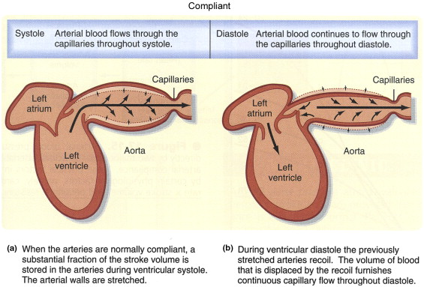
WINDKESSEL EFFECT
Hales : capacitance role of the elastic arteries, noting similarity to the dampeners used in fire engines.
Windkessel effect dampens out the pulse pressure, there by lower SBP.
Windkessel effect helps in damping the fluctuation in pulse pressure over the cardiac cycle and assists in the maintenance of organ perfusion during diastole when cardiac ejection ceases
Notes:
Hales studied horse circulatory system and clarified the capacitance role of the elastic arteries, noting the similarity of this role to the pulse dampeners used in fire engines.
At the end of ventricular systole, the pressure in the aorta falls much more slowly than in the LV because the large central arteries (particularly the aorta) are elastic and thus act as a reservoir during systole, storing some of the ejected blood, which is then forced out into the peripheral vessels during diastole.

Slide 12
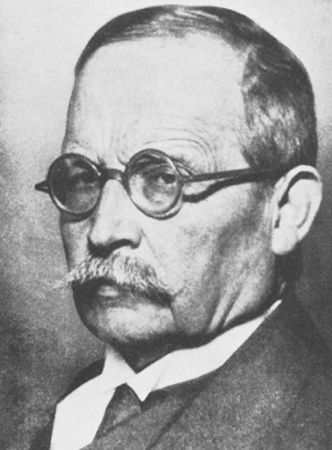
TWO-ELEMENT WINDKESSEL MODEL
Frank’s model
Provides a simple way to approximate the drop
in pressure in the aorta during diastole.
Notes:
4 elements
Aortic compliance
AORTIC IMPEDENCE
PVR
PV COMPLIANCE

Slide 13
GENERATION OF A PULSE WAVE
Cardiac systoli produces compression waves - PRESSURE (PULSE) WAVE & VELOCITY WAVE
Travels @ a rate greater than velocity of the column of blood.
When it reaches a zone of increased impedance, a fraction of that wave is reflected backward, with the magnitude proportional to the magnitude of the impedance
Appearance of a new REFLECTED PRESSURE WAVE OR Increased magnitude of an existing reflected pressure wave
They fluctuate with each waveforms.
Notes:
arterioles

Slide 15
Different pulse wave morphologies in different arteries are the result of local summation of incident & reflected pressure waves.
If, zone of decreased impedance (aneurysmal dilatation), the pattern of change in pressure waves is the opposite.

Slide 16
PULSE PRESSURE CONTOUR IN ASCENDING AORTA
Notes:
INCISURA ISOVOLUMETRIC RELAXATION PERIOD, A2

Slide 17
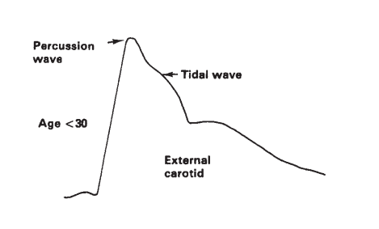
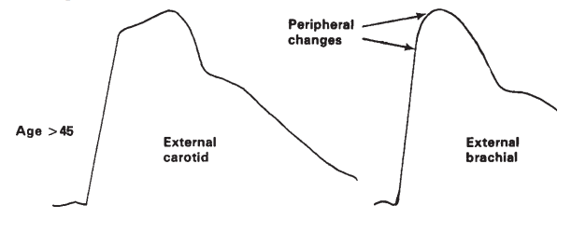
Initial tap – by a rapid rise to the peak = percussion wave
Slower rise – formed by the fusion of percussion wave & reflected waves from areas where arteries divide = tidal wave
Normal : feels like a gentle tap against the finger tip
> 45 years : tap – f/b – slower rise
In older age groups , anacrotic notch/shoulder occurs = feels like a tap & push
Notes:
Anacrotic notch . Peripherally it disappears.

Slide 18
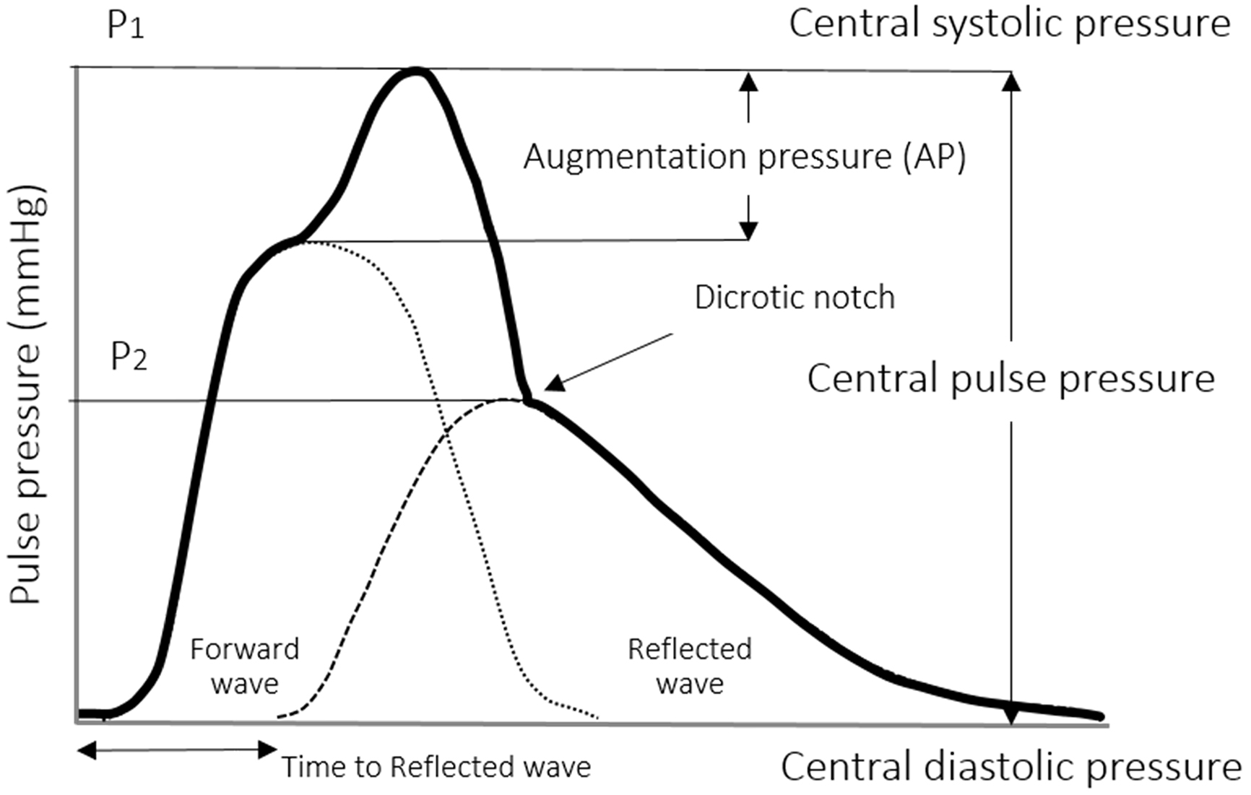
Systolic componant = forward
pressure wave
Diastolic componant =
reflected pressure wave
Pulse pressure waveform is a
summation of both
Notes:
early return to the heart of the reflected waves is caused by stiff arteries that increase the speed of the traveling pressure waves and change the pressure waveform by increasing the central systolic and pulse pressures

Slide 19
AUGMENTATION PRESSURE
Additional aortic systolic pressure produced by the return of the reflected waves at the central aorta
AUGMENTATION INDEX
Augmentation pressure as a percentage of the central pulse pressure
Central augmentation index
AP/PP
Peripheral augmentation index
Late systolic pressure / early systolic pressure
Notes:
index is typically measured as the difference of the first systolic (P1) and second pressure peak (P2), which is represented as a percentage of the pulse pressure (PP) (%) = (P1 - P2) × 100/PP
O’ROURKE AND ASSOCIATES

Slide 20
Measure of arterial wave reflection & systemic arterial stiffness
Predictor of adverse cardiovascular events
For understanding cardiac afterload
Increased by aging, HTN, atherosclerosis.

Slide 21
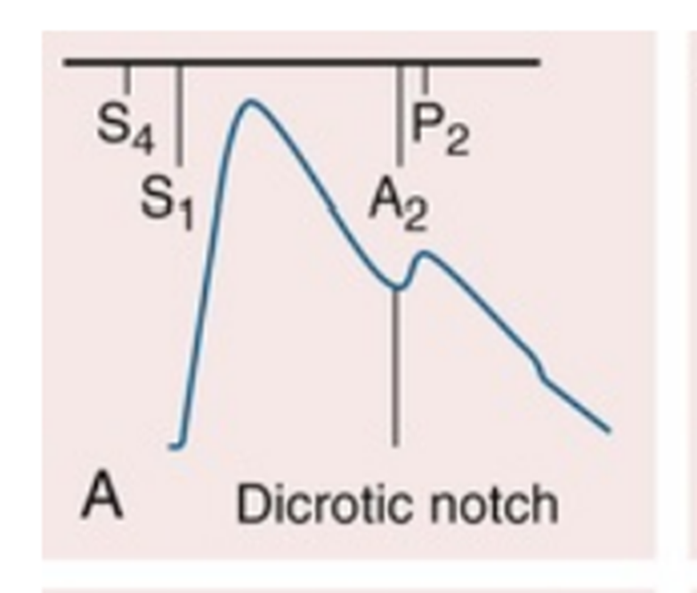
TIMING WITH CARDIAC CYCLE
Incident (percussion) wave begins with systolic ejection (just after s1)- the predominant monophasic pulse appreciated at the bedside.
The incisura or dicrotic notch identifies aortic valve closure (a2)
Notes:
IVRELAXATION

Slide 22
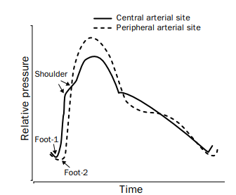
PULSE WAVE AS IT MOVES TOWARDS PERIPHERY
Upstroke velocity & amplitude increases
Short systolic upstroke time
Anacrotic notch disappears
Lower dicrotic notch
Notes:
Peripheral arteries are not used to assess the contour
But can be used to assess pulsus paradoxus & alternance.
Area under the curve is preserved
SBP INCR
DBP & MEAN BP DECR.
The moment-to-moment transmural arterial pressures are widely different.

Slide 23
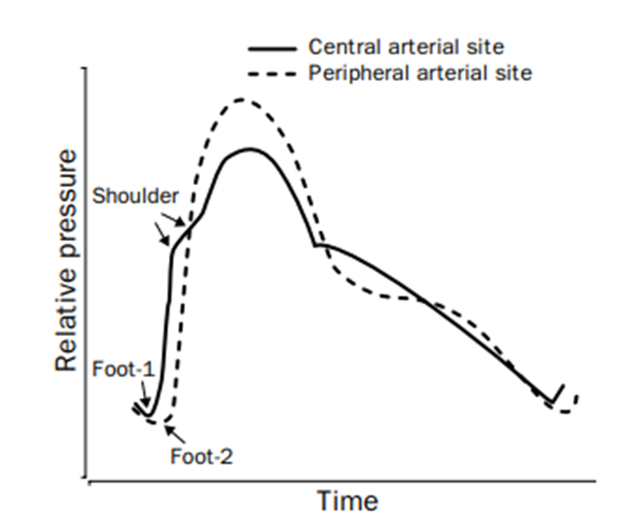
CENTRAL ARTERY (AORTA)
PERIPHERAL ARTERY (BRACHIAL)
Upstroke has a rounded dome
Anacrotic notch on ascending limb
Descending limb has incisura f/b dicrotic wave
Steep upstroke
Disappearance of anacrotic notch
Sharp incisura is replaced by a smoother and latter dicrotic notch, f/b dw

Slide 24
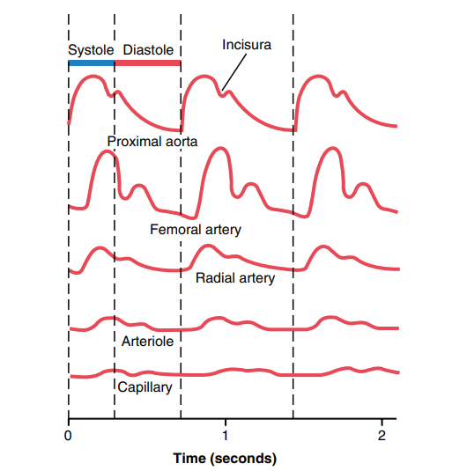
REASON FOR THE CHANGE FROM CENTRAL TO PERIPHERY
Damping
Due to summation of forward-and backward traveling waves at each location
Different rates of transmission of various componants
Difference in distensibility & caliber of arteries
Changes in the vessel wall

Slide 25
DAMPING
Occurs in the smaller arteries, arterioles & capillaries.
Due to:
(1) resistance to blood flow
(2) compliance of the vessels
Only when the aortic pulsations are extremely large or the arterioles are greatly dilated, capillary pulsations can be observed
Notes:
SMALL AMOUNT OF BLOOD FLOW FORWARD AT THE PULSE WAVE FRONT TO DISTEND THE NEXT SEGMENT OF THE VESSEL
GREATER THE RESISTANCE, MORE DIFFICULT.
THE MORE COMPLIANT A VESSEL, GREATER THE QUANTITY OF BLOOD REQUIRED AT THE PULSE WAVE FRONT TO CAUSE AN INCREASE IN PRESSURE.

Slide 26
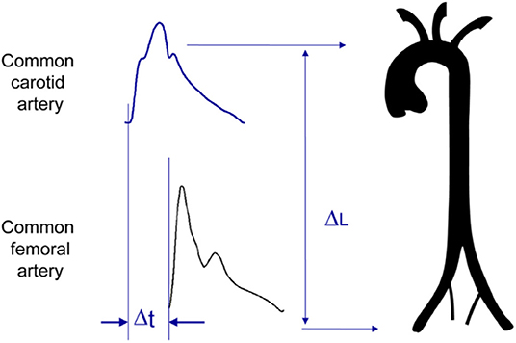
TIME LAG FROM CARDIAC CYCLE
CAROTID : 40 MSEC
BRACHIAL : 60
RADIAL : 80
FEMORAL : 75

Slide 27
EXAMINATION OF PULSE
WHICH ALL PULSES CAN BE EXAMINED…… ?
RADIAL
BRACHIAL
CAROTID
FEMORAL
POPLITEAL
DORSALIS PEDIS
POSTERIAL TIBIAL
FACIAL
SUPERFICIAL TEMPORAL ARTERY
COMPARE BILATERALLY

Slide 28
VESSEL | POSTURE | AGAINST….
RADIAL | Forearm slightly pronated and wrist slightly flexed | Radial head/styloid process
BRACHIAL | Ul in supination & elbow extended, medial to biceps tendon | Distal humerus
AXILLARY | Medial aspect of arm | Middle of humerus
CAROTID | Medial to scm muscle @ cricoid cartilage level, head turned towards examiner | Chassaignac tubercle
SUPERFICIAL TEMPORAL | Anterior to tragus | Zygomatic process
FACIAL | Anterioinferior aspect of masseter muscle | Mandible
SUBCLAVIAN | Shoulder depressed, in the angle b/w the scm & clavicle | First rib
Notes:
RADIAL : tip of index, middle and ring fingers
CAROTID : RT thumb for LT carotid. Terminates at C4 level at the upper border of thyroid cartilage. Best felt in the lower half of the patient’s neck. Rotating the neck slightly towards the examiner, relaxes SCM.
Against anterior tubercle of the transverse process of c6 vertebra, known as carotid tubercle
Pressure exerted down back and medially in the angle between the SCM and clavicle

Slide 29
ARTERY | POSITION | AGAINST
FEMORAL | Below the inguinal ligament, medial to mid inguinal point | Head of femur
POPLITEAL | Knee in semi flexed posture, by using fingers of both hands, in the popliteal fossa | Distal femur
DORSALIS PEDIS | Dorsum, lateral to extensor hallucis longus tendon | Navicular bone
POSTERIOR TIBIAL | 1cm posterior to medial malleoli | Talus, Calcaneum
Notes:
DPA – NOT PALPABLE IN 2%.

Slide 30
GRADING OF PULSE
GRADE 0 - Absent pulse
GRADE 1 - Feeble
GRADE 2 - Palpable but diminished
GRADE 3 - NormaL
GRADE 4 - High volume/bounding

Slide 31
DESCRIPTION OF PULSE
RATE
RHYTHM
VOLUME
CHARACTER & CONTOUR
WHETHER SYNCHRONOUS WITH OTHER PULSES
STATE OF VESSEL WALL
Notes:
Bruit over artery
Fundus examination
Allens test

Slide 32
A. RATE … SLOW, NORMAL OR FAST
TACHYCARDIA
BRADYCARDIA
SINUS TACHYCARDIA
PHYSIOLOICAL
PHARMACOLOGICAL
EPI, ISOPROTERENOL, EPHEDRINE,
ATROPINE, ALCOHOL, NICOTINE, CAFFEINE
PATHOLOGICAL
HF, MI, MYOCARDITIS, SHOCK, PE
FEVER, THYROTOXICOSIS, ANEMIA,
HEMORRHAGE, HYPOXIA
TACHYARRHYTHMIA
AF, AT, SVT
SINUS BRADYCARDIA
PHYSIOLOGICAL
PHARMACOLOGICAL
BETA BLOCKER, PROPAFENONE,
LITHIUM
PATHOLOGICAL
IWMI, VASOVAGAL, SA BLOCK,
POST CARDIAC TRANSPLANT MYXODEMA, RAISED ICP,
HYPOTHERMIA, OBSTR JAUNDICE,
ENTERIC FEVER, SEPSIS, CHAGAS D/S
FAGOT SIGN
BRADYARRHYTHMIA
CHB , 2ND DEGREE AVB
Notes:
COUNT OVER 30 SECS TO 1 MINUTE NORMAL 60/MIN TO 100/MIN

Slide 33
B. RHYTHM …. REGULAR/IRREGULAR
REGULARLY IRREGULAR PULSE
IRREGULARLY IRREGULAR PULSE
REGULAR PULSE
SINUS
PSVT
JUNCTIONAL RHYTHM
ATRIAL TACHY WITH FIXED BLOCK
ATRIAL FLUTTER WITH FIXED BLOCK
VT
V BIGEMINY
V TRIGEMINY
2ND DEGREE HB
SINUS ARRHYTHMIA WITH PHASIC VARIATION
(RESP & NON RESP)
(DIGITALIS TOXICITY)
AF
FLUTTER WITH VARYING BLOCK
MULTIFOCAL VPC
MAT
Notes:
Ventricular premature complex - large pause following the premature beat.
Atrial premature complex - short pause following two beats

Slide 34
C. VOLUME …. LOW, NORMAL OR HIGH
HYPERKINETIC INCR. LV EJECTION VELOCITY HIGH STROKE VOLUME | HYPOKINETIC
AR, CHB, TA, PDA | NORMAL CO - WITH SEVERE VASOCONSTRICTION
S. HTN | LOW CO HYPOTENSION LV DYSF CCF
HIGH OUTPUT STATES ANEMIA ANXIETY THYROTOXICOSIS EXERCISE AV FISTULA PDA ALCOHOL INTAKE HOT &HUMID CLIMATE | RATE OF RISE SLOW RISING – LVOTO NORMAL UPSTROKE – NO LVOTO
Notes:
BEST…. CAROTID
AMPLITUDE AUGMENTED… DECREASED ARTERIAL COMPLIANCE (WALL THICKENING,
SYSTEMIC VASOCONSTRICTION)

Slide 35
D. CHARACTER & CONTOUR
BEST……CAROTID
The palpable pulse reflects the merging of the antegrade pulsatile flow of blood and the propagated pulse returning from the periphery.
The contour depends on :
STROKE VOLUME
EJECTION VELOCITY
VASCULAR COMPLIANCE
SYSTEMIC RESISTANCE
Notes:
CAROTID ART CONTOUR ALMOST SIMILAR TO THE CENTRAL AORTIC PULSE

Slide 36
SPECIFIC CONDITIONS
PULSUS PARADOXUS :
Term coined by Adolph kussmaul in 1873
Marked inspiratory fall in sbp by
> 10 mmhg
Exaggeration of a normal physiological phenomenon
Associated conditions :
1) Cardiac tamponade
2) Constrictive pericarditis
3) Severe chf
4) RV infarct
5) Asthma
6) Emphysema
7) Obesity, Pregnancy
8) Pulm embolism
9) SVC obstruction
Notes:
PULSUS NORMALIS AGGRECANS
We can hear HS, cant feel the pulse
Rt = VC extra thoracic & RA intra.
LT= PV & LA intrathoracic
Inspiration → only VENOCAVO-ATRIAL gradient increases.
VENTRICULAR INTERDEPENDANCE, PHASIC CHANGES IN BLOOD FLOW TO VENTRICLES

Slide 37
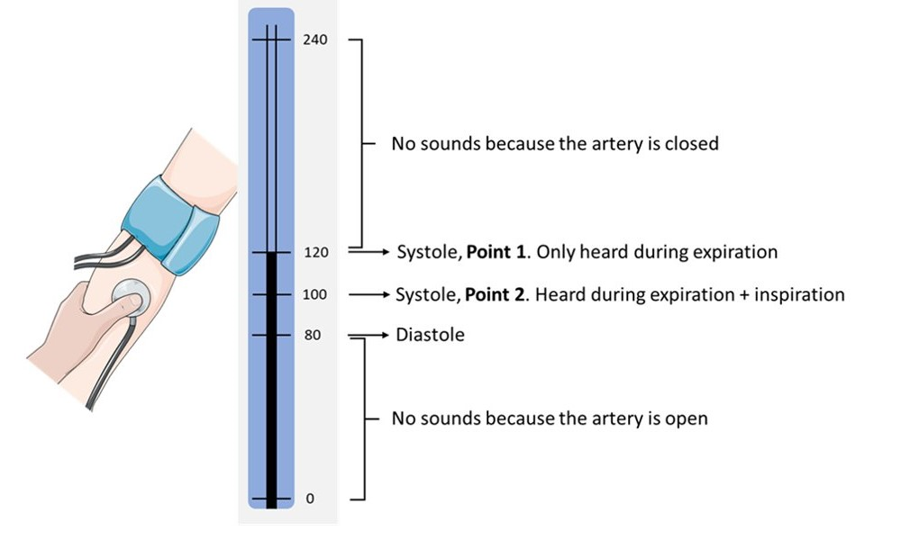
MEASURING PULSUS PARADOXUS…..

Slide 38
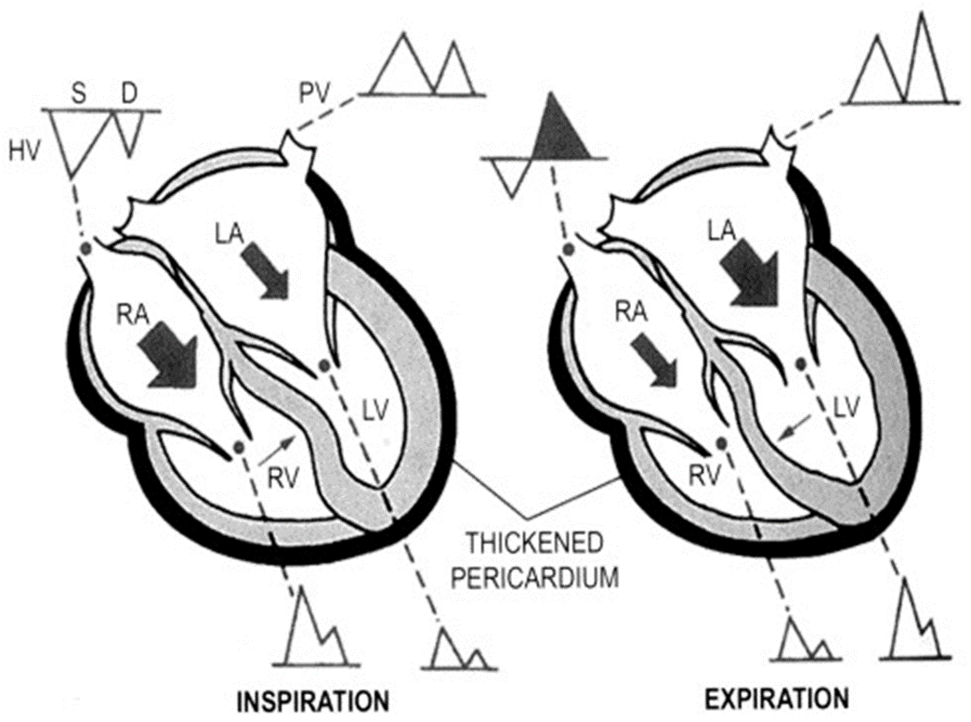
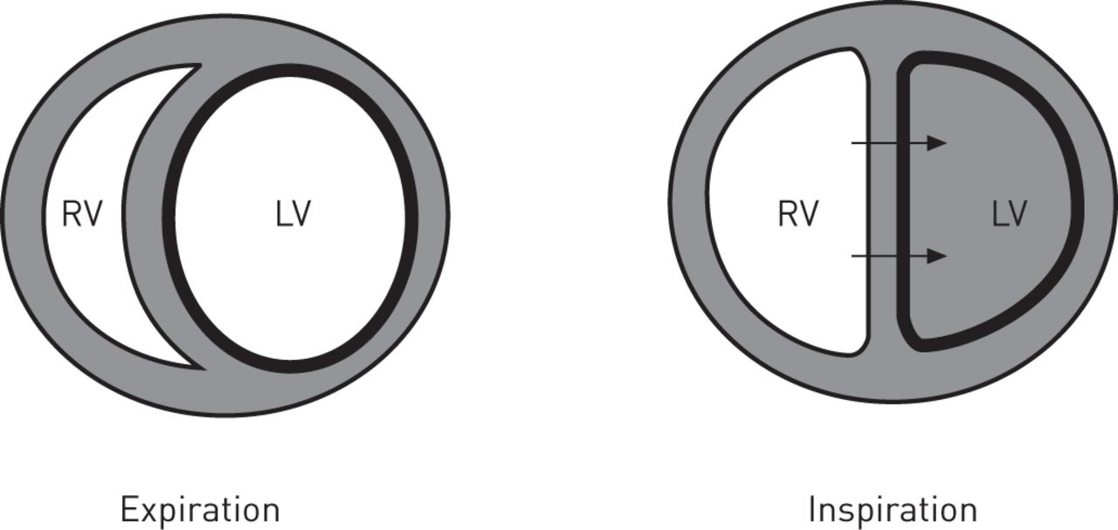
1) CARDIAC TAMPONADE 2) CONSTRICTIVE PERICARDITIS
Notes:
Tamponade effect, Poor ventricular diastolic filling.
thickened pericardium will prevent the normal decrease in pressure from reaching the ventricles; thus, the normal drop in filling pressures will be blunted

Slide 39
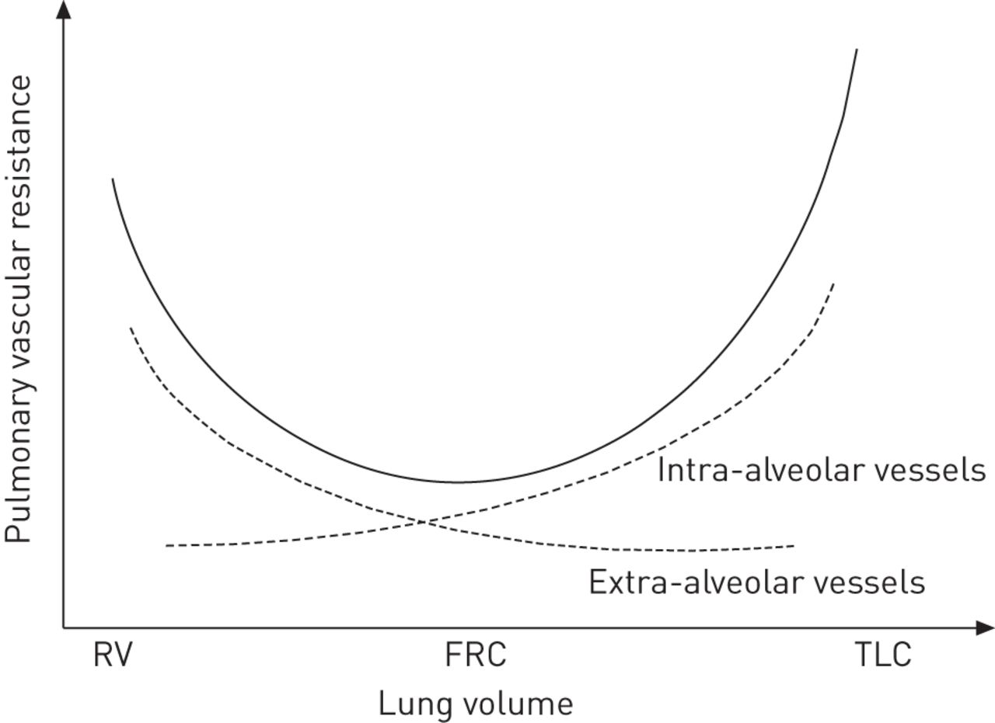
3) ASTHMA & EMPHYSEMA
Pulsus paradoxus with modest fall (<15mmhg)
Not palpable
4) OBESITY
Increased work of breathing & ITP fluctuation
Notes:
3) SEVERE CHF
Heart is pulled inferiorly during insp, raises intrapericardial pressure & diminishes venour return
HUGE FALL IN ITP. left ventricular transmural pressure is the sum of the intracavitary pressure minus the negative intrathoracic pressure generated during inspiration.
As the left ventricle contracts during inspiration, against negative intrathoracic pressure. This increases left ventricular wall stress and afterload and effectively decreases systolic aortic pressure.
INCR. INTRAVASC VOLUME OF PULM VESSELS
v.interdependence.
right ventricular afterload increase.
No change in PP in COPD, asthma
reduced left ventricular preload
Increased left ventricular afterload

Slide 40
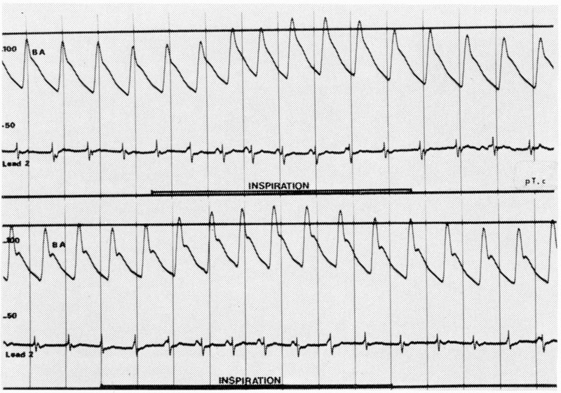
REVERSE PULSUS PARADOXUS :
Increase in SBP with inspiration
HOCM
Isorhythmic atrioventricular (AV) dissociation
Intermittent positive pressure ventilation (IPPV)
Notes:
P BEFORE QRS IN INSP. & P MARCHES INTO QRS DURING EXP. = INCREASE CO IN INSP. + ITP IN INSP.
In EXP sinus rate is slow, In INSP. Sinus node takes over

Slide 41
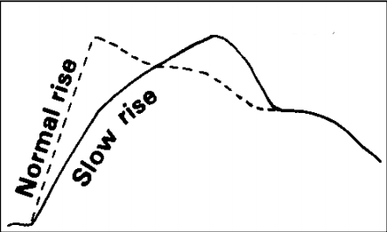
PULSUS PARVUS :
Slow rising low volume
Best…carotid
Severe AS , heart failure
PULSUS TARDUS :
Late peaking, near to S2
Best...Simultaneuos auscultation and carotid palpation
In fixed LVOT obstruction
Notes:
SLOW RAISING PULSE : GRADIENT OF 70 MMHG ACROSS AV

Slide 42
ANACROTIC PULSE :
Pulsus parvus et tardus with accentuation of anacrotic notch
Slow upstroke
Delayed peak, small volume
In severe AS
Severe the stenosis earlier the anacrotic notch

Slide 43
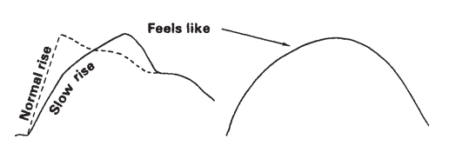
Aortic Stenosis
Absence of a tap
a gentle lift/push
Thrill… left carotid than right
Lag btw apical & carotid impulse …. valve area of <1 cmsq
AS with normal rate of rise in carotids
Mild AS
Severe atherosclerosis
Supravalvular AS, CoA
HOCM
Notes:
IN SEV. ATHEROSCLEROSIS…DUE TO INABILITY OF NONCOMPLIANT AORTA TO EXPAND SLOWLY.
Associated MS, AR

Slide 44
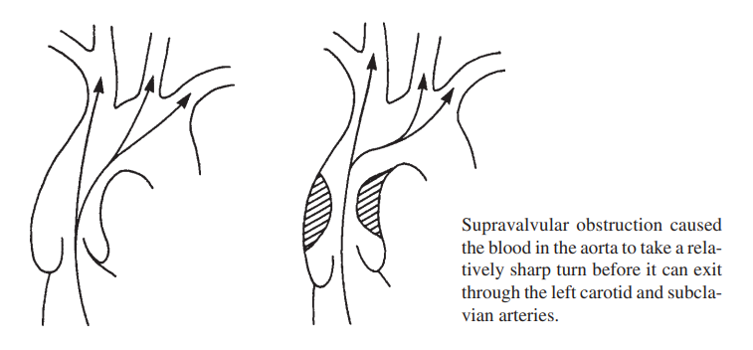
Mild AS Supravalvular AS Rate of rise & BP are more on right than left COANDA SIGN COANDA EFFECT

Slide 45
WATER HAMMER PULSE (PULSUS CELER) :
COINED BY THOMAS WATSON
DUE TO :
DIASTOLIC RUNOFF – AR, PDA, AP WINDOW, RSOV TO RT SIDE, AV FISTULA
CCHD - TA WITH TRUNCAL RUN OFF TO PA/TRUNCAL
INSUFFICIENCY
PULM ATRESIA WITH AP COLLATERAL
TOF WITH AP COLL. / PDA / AR / AFTER BT SHUNT
REFLEX VASODILATION
RAPID RUN OFF FROM PERIPHERY
NORMAL VOLUME COLLAPSING PULSE : MR VSD
Notes:
REFLEX VASODILATION MEDIATED BY CAROTID BARORECEPTORS DUE TO LARGE STROKE VOLUME
RAPID RUN OFF FROM PERIPHERY DUE TO REDUCED SYSTEMIC VASCULAR RESISTANCE
PALPATED USING PALMAR SURFACE OF FINGERS, HAND RAISED ABOVE HEAD
ARTERY BECOMES MORE IN LINE WITH AORTA

Slide 46
JERKY PULSE :
BRISK UPSTROKE, TAPING
VOLUME NORMAL
NORMAL DOWNSTROKE
IN HCM

Slide 47
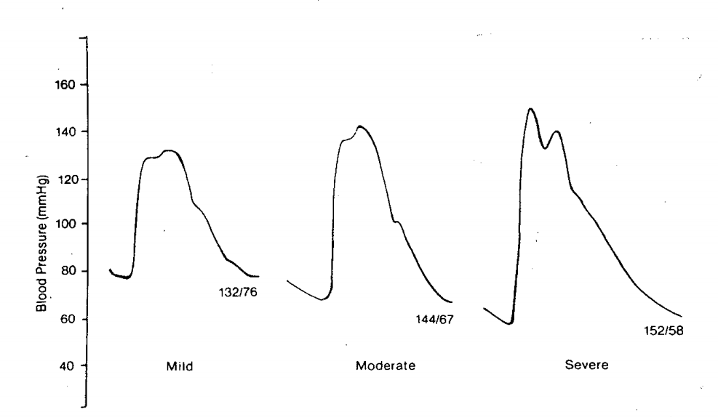
Aortic Regurgitation
Degree of decrease in DBP is proportional to severity
Severe AR is not common if BDP > 60 mmhg.
A DBP </=50 always indicate a major degree of aortic incompetence
Notes:
LARGE LV STROKE VOLUME GIVES A RAPID UPSTROKE. F/B SUDDEN FALL OFF IN LATE SYSTOLE GIVING A COLLAPSING PULSE NATURE
DBP : POINT OF MUFFLING OF KOROTKOF SOUND

Slide 48
PERIPHERAL SIGNS OF AR
DE MUSSETS SIGN - HEAD BOBBING
LIGHT HOUSE SIGN
LANDOLFIS SIGN
QUINKES SIGN
MULLERS SIGN
CAROTID SHUDDER
CORRIGANS PULSE
JULIANS SIGN : PULSATION OF RETINAL VESSELS
MINERVINI’S SIGN : STRONG LINGUAL PULSATIONS
LOGUE’S SIGN : PULSATION OF STERNOCLAVICULAR JUNCTION, WHEN AR IS ASSOCIATED WITH AORTIC DISSECTION
Notes:
DENNISONS : CERVICAL PULSATIONS

Slide 49
BISFERIENS : 2 PEAKS
LOCOMOTOR BRACHIALIS
HILLS SIGN (SBP DIFFERENCE >20)
PISTOL SHOT FEMORALIS
TRAUBES SIGN
DUROZIES MURMER
PALFREY’S SIGN : PISTOL SHOT SOUND OVER RADIAL
ROSENBACHS SIGN
GERHARDTS SIGN
DENNISONS SIGN
Notes:
Dennisons sign pulsatile cervix

Slide 50
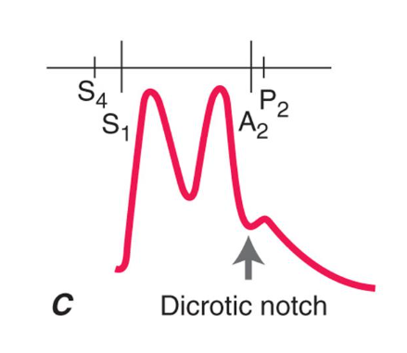
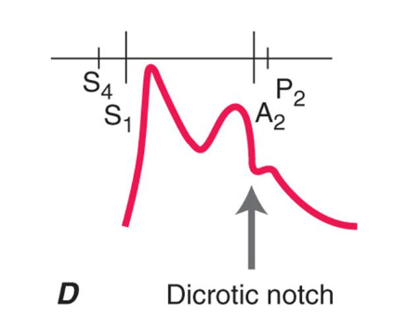
PULSUS BISFERIENS :
In AS + AR , the stenotic componant permits a jet, lateral to which pressure falls (bernoulli phenomenon), leads to dip in pulse, with secondary positive wave - tidal wave.
In HOCM , Rapid upstroke of PW , slow upstroke of TW
k/a SPIKE & DOME PATTERN
ALSO SEEN IN,
SEVERE AR
AS WITH AR
HOCM
Notes:
HOCM, OBSTRUCTION IN LATER SYSTOLI DUE TO SAM

Slide 51
PULSUS BIGEMINI :
Disorder of cardiac rhythm
Normal beat f/b ectopic beat
Reduced diastolic filling
In digitalis toxicity

Slide 52
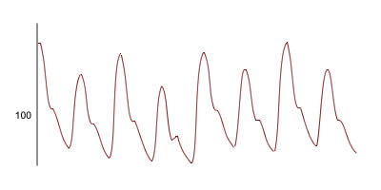
PULSUS ALTERNANS :
First described by TRAUBE in 1872
Alterations in the amplitude of pressure pulse
Alterations in the pulse volume
Better felt in radial artery
Usually S3 (+)
Inflate BP cuff above SBP, slowly deflate. Initially korotkof sound is heard only for every alternate beats, later its audible for each beat.
DUE TO
LV FAILURE
FAILURE OF ELECTROMECHANICAL COUPLING
Notes:
DUE TO ALTERATIONS IN THE CONTRACTILE STATE OF MYOCARDIUM.
Ca LOADING & UNLOADING THEORY.
NOT TO BE CONFUSED WITH ELECTRICAL ALTERNANCE.

Slide 54
TYPES OF PULSUS ALTERNANS
PARTIAL – Involve either RV (in PE) or LV (in AS)
TOTAL – Weak beat is not percieved / involve both RT & LT heart
CONCORDANT – Simultaneous alternans of RT & LT ventricle
DISCORDANT – Alternating atlernans of RT & LT ventricle
PRECIPITATING EVENTS
MI, DCM
Pulm embolism
Severe AS / PS with failure
Severe AR with LVF after AVR
Intracoronary contrast injection
Transient RVOTO during balloon dilatation of PS
Rapid atrial pacing
PVC

Slide 55
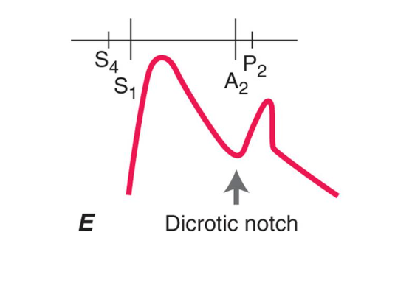
DICROTIC PULSE :
1 systolic & 1 diastolic beat
Requirements : low PVR
Hypotension
CCF
IABP
HYPOVOLUMIC SHOCK
POST AVR
CT
SEPSIS
Notes:
WHEN THE REFLECTED WAVE MEETS THE ORIGINAL WAVE EARLY.

Slide 56
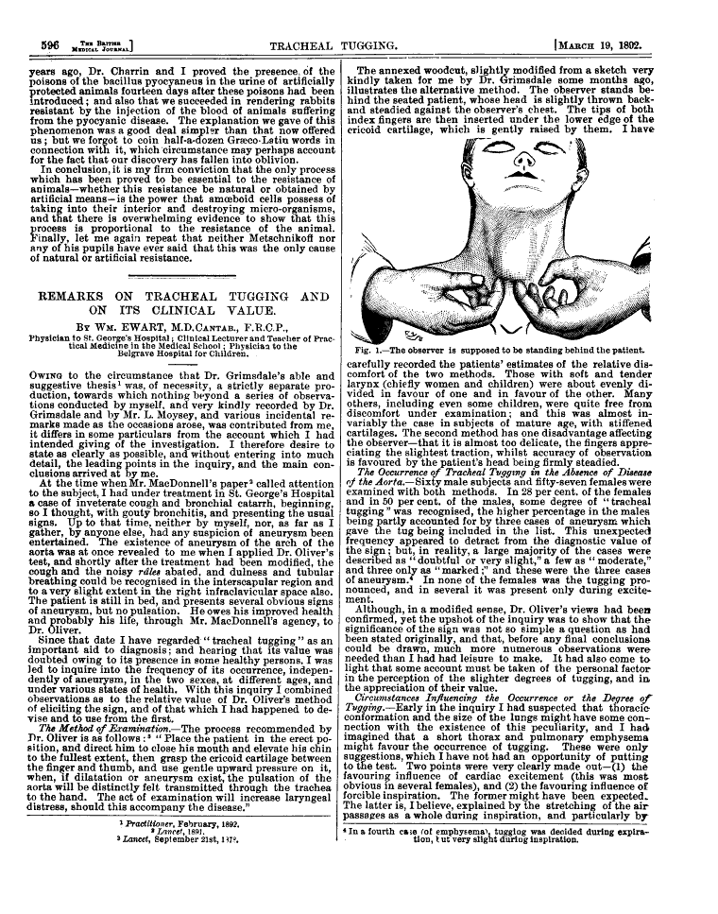
AORTIC ARCH ANEURYSM
TRACHEAL TUG SIGN (OLIVER SIGN)
CARDARELLI’S SIGN
Notes:
OLIVER : "Place the patient in the erect position, and direct him to close his mouth, and elevate his chin to the fullest extent, then grasp the cricoid cartilage between the finger and thumb, and use gentle upward pressure on it, when if dilatation or aneurism exist, the pulsation of the aorta will be distinctly felt transmitted through the trachea to the hand. This act of examination will increase laryngeal distress should this accompany the disease
Laryngotracheal tube pulsation felt with leftward laryngeal displacement, related to aortic arch dilatation and aneurysms

Slide 57
D. SYNCHRONOUS….OR NOT
RADIORADIAL DELAY
Slow rate of rise & delayed peak
Seen in :
Aortoarteritis
Thrombormbolism
Cervical rib
Scalenus anticus syndrome
Anomalous RT subclavian artery
Aberrant radial artery course
Aortic dissection

Slide 58
RADIOFEMORAL DELAY :
Slow rate of rise & delayed peak
Delay & low volume
Seen in
CoA
Occlussive d/s of aortoiliac bifurcation/common iliac/ext iliac artery
Supravalvular AS
CoA WITHOUT RFD :
CoA with Supravalvular AS
CoA with MR
CoA + BAV with AS / AR
Pseudocoarctation

Slide 59
PULSE DIFICIT
APEX PULSE DEFICIT OF > 10 bpm S/O AF
UNEQUAL CAROTIDS
Aortoarteritis
Aortic aneurysm
Atherosclerosis, atheroembolism
Supravalcular AS

Slide 60
UNEQUAL FEMORALS:
Dissecting aneurysm
CoA
Pseudoxanthoma elasticum
Hypoplastic ext iliac artery

Slide 61
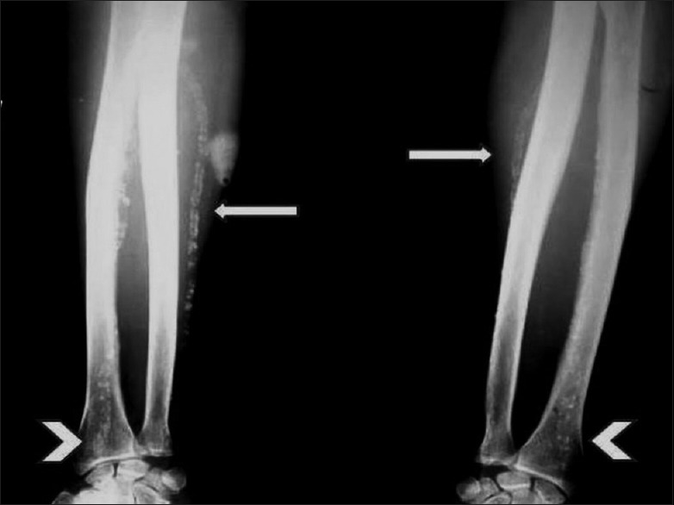
E. VESSEL WALL…. IS IT SOFT/HARD? …. TOO EASILY ROLLABLE UNDER THE FINGER?
Soft , normal
Thickened, chord like - severe atherosclerosis OSLER SIGN
Due to MONCKEBERG’S SCLEROSIS of arteries
Degenerative d/s
Calcification of media of small & medium arteries
Arteries of ul, ll, renal & coronary arteries
X-ray : “rail-tracking” appearance
Pseudo HTN should be ruled out
Notes:
Palpable but PULSELESS, RADIAL artery even with BP cuff inflated to supra systemic range.
M. Different from atherosclerosis where the intimal layer is involved resulting in narrowing of the lumen.

Slide 62
DEGENERATIVE CHANGES

Slide 63
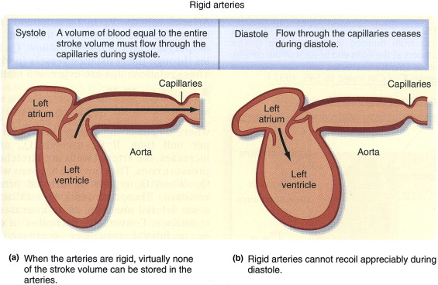
PULSE WAVE CHANGES WITH AGING

Slide 64
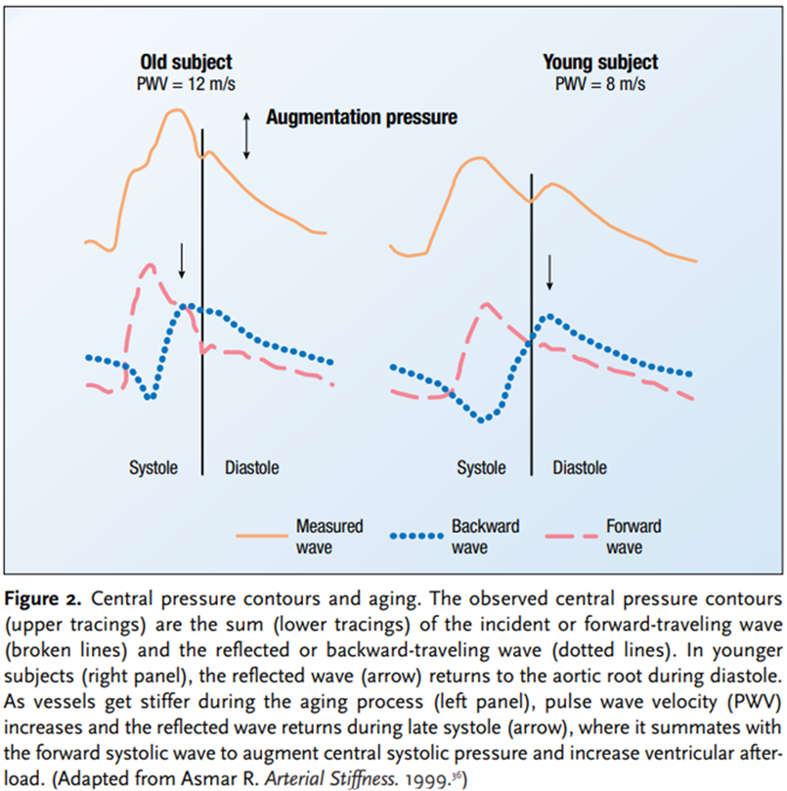
Tidal wave height increased
Incisura height increased
Longer systolic upstroke time
Dicrotic wave amplitude & duration decreases
TW taller than PW

Slide 65
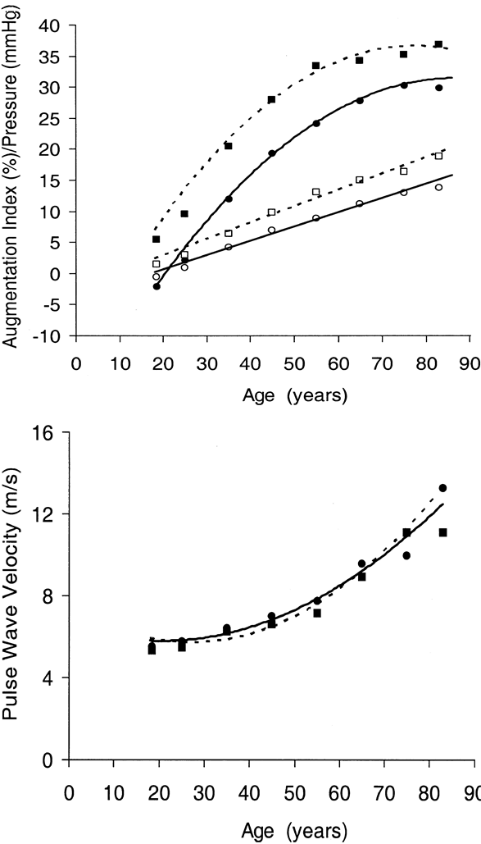
Notes:
B. AUG PRESSURE---OPEN
CIRCLE& LINE….. MALES
DOTTED LINE & SQUARE… FEMALES

Slide 66
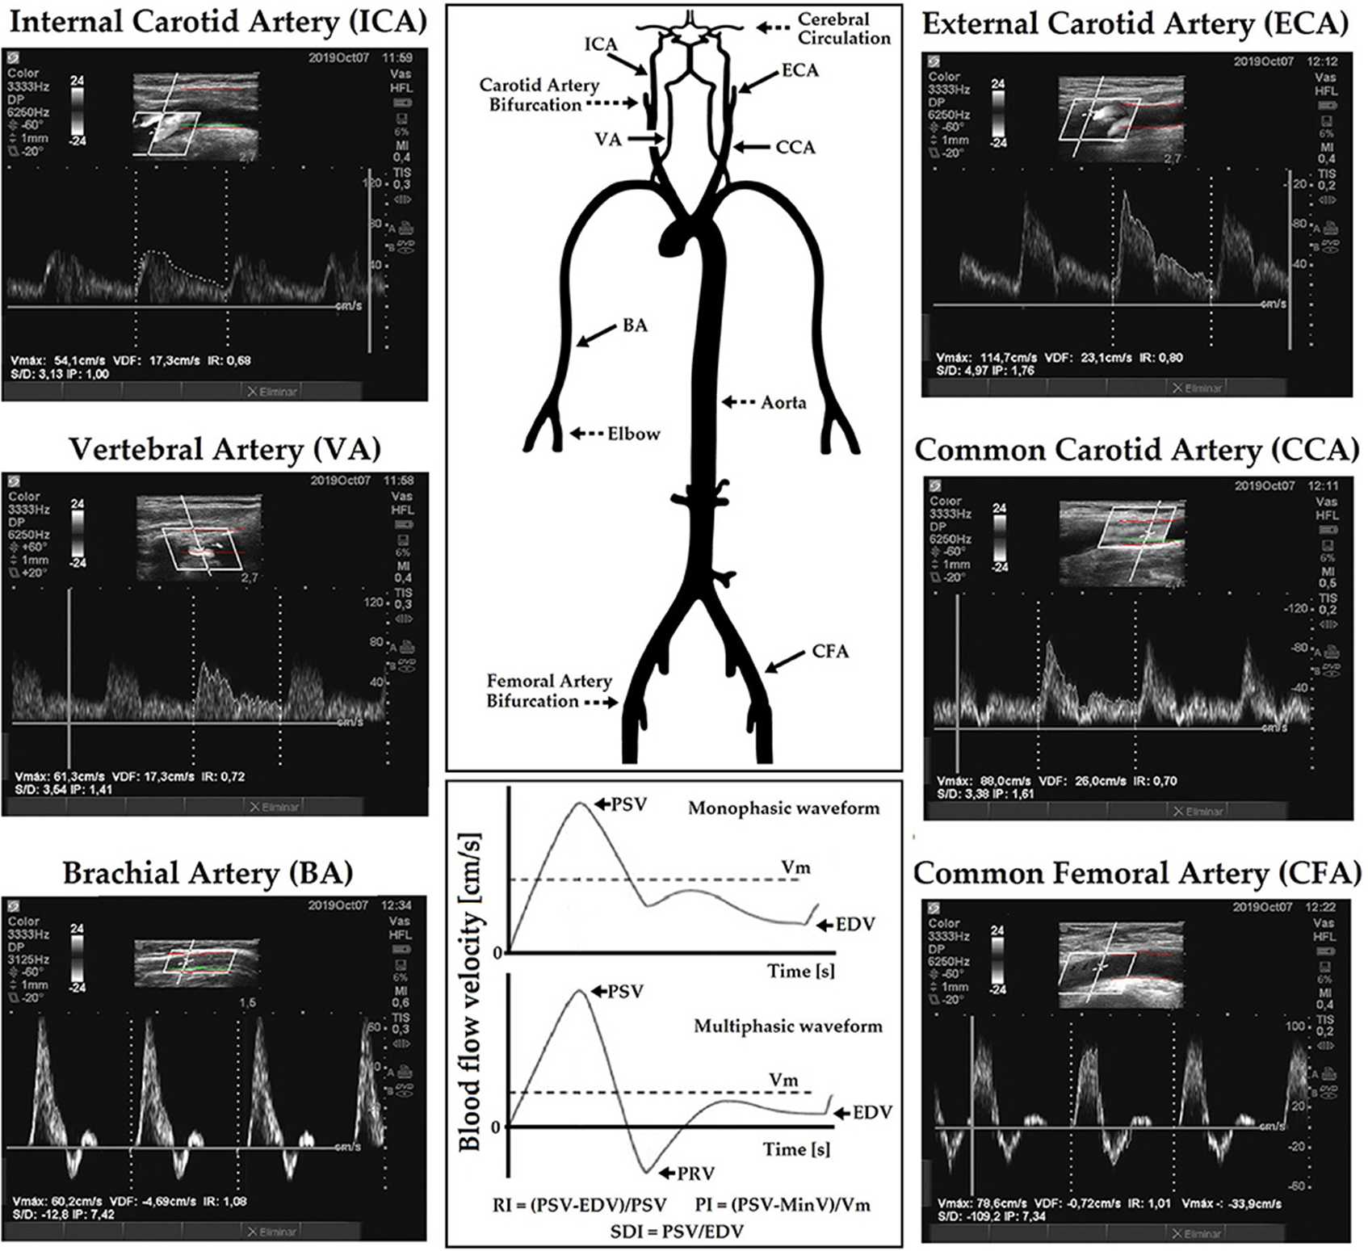
PULSE WAVE VELOCITY
To measure distensibility and stiffness of the aorta and proximal vessels
(Related to the stiffness & compliance)
To evaluate the vascular effects of both vasoactive substances and antihypertensive drug therapy
Increase with aging, hypertension, renal failure

Slide 67
THANK YOU
THANK YOU

